Slide 1
Sequential Circuits’ analysis

Slide 2
Synchronous Sequential Circuit Analysis
Analysis Pinciples
1. Determine the system variables: input, state, and output.
2. Determine the flip-flop type. Write the characteristic equations.
3. write the excitation equations.
4. write the next state equations.
5. Write the output variable equations.
Notes:
1.确定系统变量：输入变量、状态变量以及输出变量；
2.确定触发器类型，写出特征方程；
3.写出激励方程；
4.写出次态方程；
5.写出输出方程；
6.构造转换表；
7.为每个状态分配相应符号，构造状态图或状态表；
8.画出时序图（波形图）；
9.功能分析。

Slide 3
Synchronous Sequential Circuit Analysis
(cont.)
6. Construct a transition table.
7. Assign symbols to the states and construct a table or state diagram.
8. When possible, construct a timing diagram.
9. Functionality analysis
Notes:
1.确定系统变量：输入变量、状态变量以及输出变量；
2.确定触发器类型，写出特征方程；
3.写出激励方程；
4.写出次态方程；
5.写出输出方程；
6.构造转换表；
7.为每个状态分配相应符号，构造状态图或状态表；
8.画出时序图（波形图）；
9.功能分析。

Slide 4
Example 1
Analysis the following synchronous sequential circuit, suppose the present state is 00, the input sequence is 0000011111, give the timing diagram.
Notes:
1.输入x
2.输出z
3.两个JK触发器负边沿触发

Slide 5
Example 1
1. Determine the system variables: input, state, and output.
input=x
output=Z
state variables=y1 and y0
2. Determine the flip-flop type. Write the characteristic equations.
y^{n+1}=Jy^{n}’+k’y^{n}
Notes:
1.确定系统变量：输入变量、状态变量以及输出变量；
输入变量：x
输出变量：z
状态变量：y1、y0
2.确定触发器类型，写出特征方程；
y^{n+1}=Jy^{n}’+K’y^{n}

Slide 6
Example 1
3. write the excitation equations.
K₀=J₀=1
K₁=J₁=x⊕y₀
4. write the next state equations.
y₁^{n+1}=J₁y₁’+k’y₁ y₀^{n+1}=J₀y₀’+k₀’y₀
y₁^{n+1}=x’y₁’y₀ +x’y₁y₀’+xy₁’y₀’+xy₁y₀ y₀^{n+1}=y₀’
Notes:
3.写出激励方程；
4.写出次态方程

Slide 7
Example 1
5. Write the output variable equations
Z=(xy₁’)’=x’+y₁
6. Construct a transition table.
Notes:
5.写出输出方程；
6.构造转换表

Slide 8
Example 1
y₁^{n+1}= x’y₁’y₀ +x’y₁y₀’ +xy₁’y₀’+xy₁y₀
y₀^{n+1}=y₀’
Z=(xy₁’)’=x’+y₁
Y₁^{n+1} K-Map
Y₀^{n+1} K-Map
Z K-Map

Slide 9
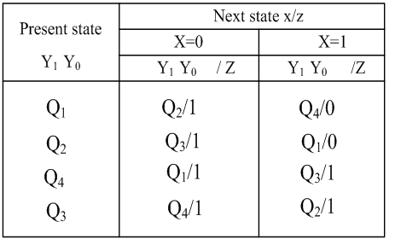
Example 1
7. Assign symbols to the states and construct a table or state diagram
Q1 | 00
Q2 | 01
Q3 | 10
Q4 | 11

Slide 10
Example 1
8. construct a timing diagram
y₁^{n+1}= x’y₁’y₀ +x’y₁y₀’ +xy₁’y₀’+xy₁y₀
y₀^{n+1}=y₀’
Z=(xy₁’)’=x’+y₁

Slide 11
Example 2
Analysis the following circuit
Notes:
4个输出Q₁~Q₄
4个D触发器正脉冲触发

Slide 12
Example 2
1. Determine the system variables: input, state, and output
state variables: Q₁,Q₂,Q₃, and Q₄
2. Determine the flip-flop type. Write the characteristic equations.
Q^{n+1}=D
3. excitation equations
D₄=Q₃ D₃=Q₂ D₂=Q₁
D₁=Q₄’(Q₃Q₁’)’=Q₄’Q₃’+Q₄’Q₁

Slide 13
Example 2
4. the next state equations
Q₄^{n+1}=Q₃
Q₃^{n+1}=Q₂
Q₂^{n+1}=Q₁
Q₁^{n+1}=Q₄’Q₃’+Q₄’Q₁

Slide 14
Example 2
5. Construct a transition table

Slide 15
Example 2
6. Assign symbols to the states and construct a table or state diagram

Slide 16
Example 2
7. construct a timing diagram
CP
Q₁
Q₂
Q₃
Q₄
S₀ S₁ S₃ S₇ S₁₅ S₁₄ S₁₂ S₈ S₀

Slide 17
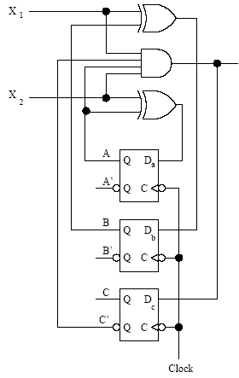
Exercise
Find the transition table and the state table for the Mealy sequential circuit below.

Slide 18
Exercise
1. Determine the system variables: input, state, and output
input: x₁,x₂
output: Z
state variable: D_{a} , D_{b} ,D_{c}
2. Determine the flip-flop type. Write the characteristic equations.
Q_{n+1}=D

Slide 19
Exercise
3. Excitation equations and output equations
D_{a}=Q_{a}⊕X₂
D_{b}=Q_{b}⊕X₁
D_{c}=X₁X₂Q_{c}’Q_{a}
Z=X₁X₂Q_{c}’Q_{a}
4. write the next state equations
Q_{a}^{n+1}=Q_{a}X₂’+Q_{a}’X₂ Q_{b}^{n+1}=Q_{b}X₁’+Q_{b}’X₁ Q_{c}^{n+1}=X₁X₂Q_{c}’Q_{a}

Slide 20
Exercise
5. Construct a transition table

Slide 21
Exercise
6. Assign symbols to the states and construct a state table

Slide 22
Counters

Slide 23
Cascaded counters 级联计数器
Cascading is a method of achieving higher-modulus counters.
For synchronous IC counters, the next counter is enabled only when the terminal count of the previous stage is reached.

Slide 24
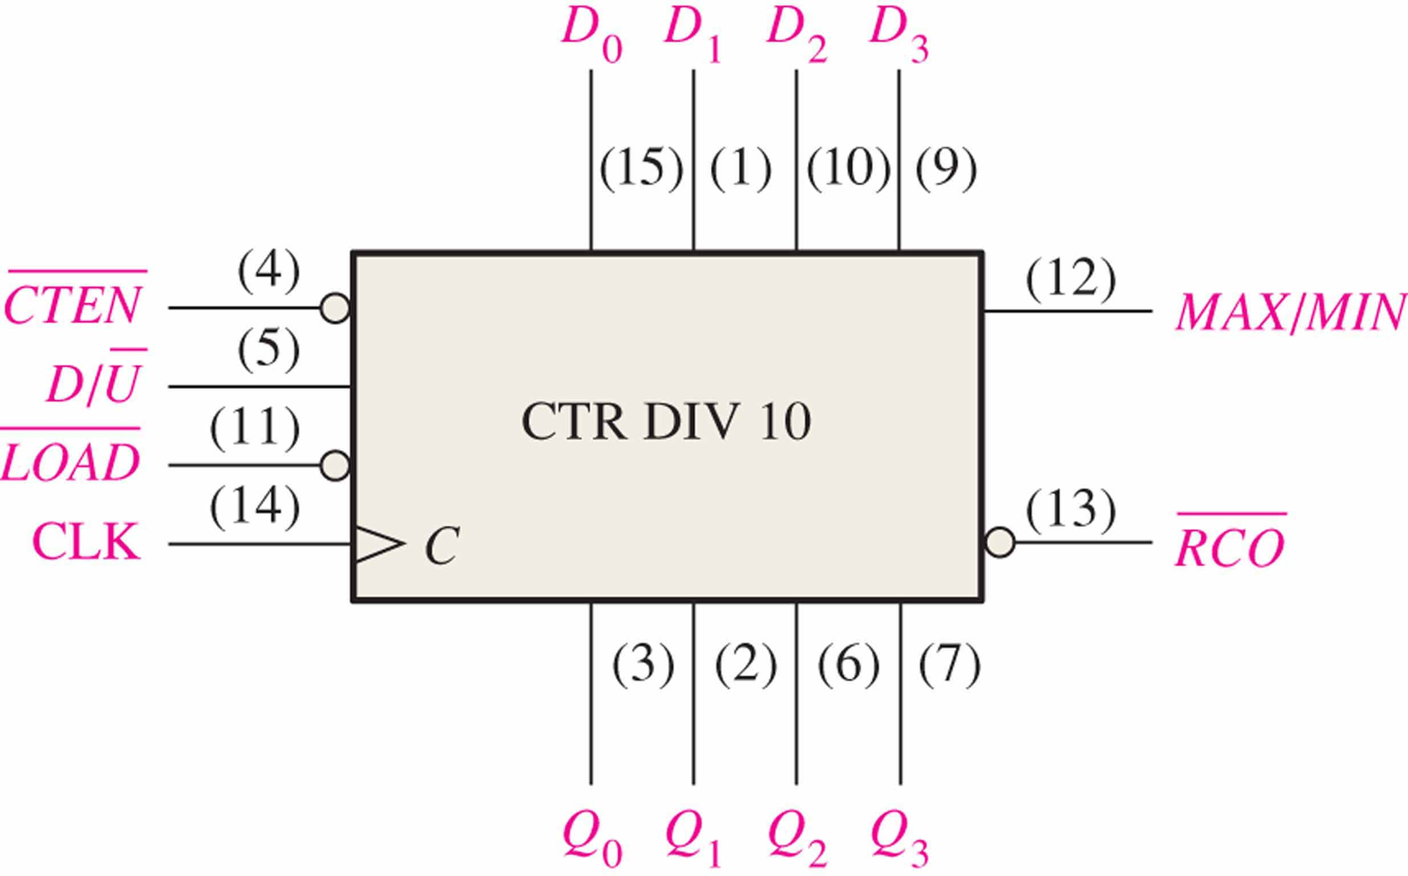

Up/Down Synchronous Counters
The count enable input.
The 74HC190 is a high speed CMOS synchronous up/down decade counter with parallel load capability. It also has a active LOW ripple clock output ($\overline{\text{RCO}}$) and a MAX/MIN output when the terminal count is reached.
The ripple clock output.

Slide 25
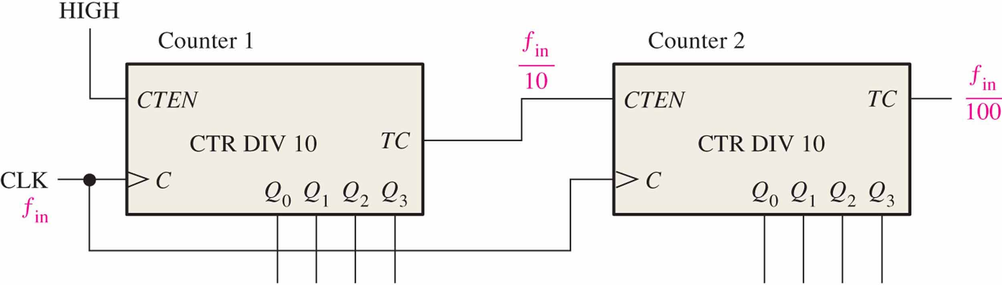
Cascaded counters
A modulus-100 counter using two cascaded decade counters
The terminal count(TC) is analogous to ripple clock output(RCO) on some IC counters.
If f_{in} =100 kHz, what is f_{out}?
f_{out} ：100 kHz/100=1kHz
Notes:
当第10个脉冲(CLK10)到来时，芯片1的TC为高，第二片芯片的CTEN处于有效使能状态，计数一次
当第20个脉冲(CLK20)到来时，芯片1的TC为高，第二片芯片的CTEN处于有效使能状态，计数一次。
……
当第100个脉冲(CLK100)到来时，芯片1的TC为高，第二片芯片的CTEN处于有效使能状态，计数一次，此时芯片2的TC为高。
所以，总的模为10*10=100

Slide 26
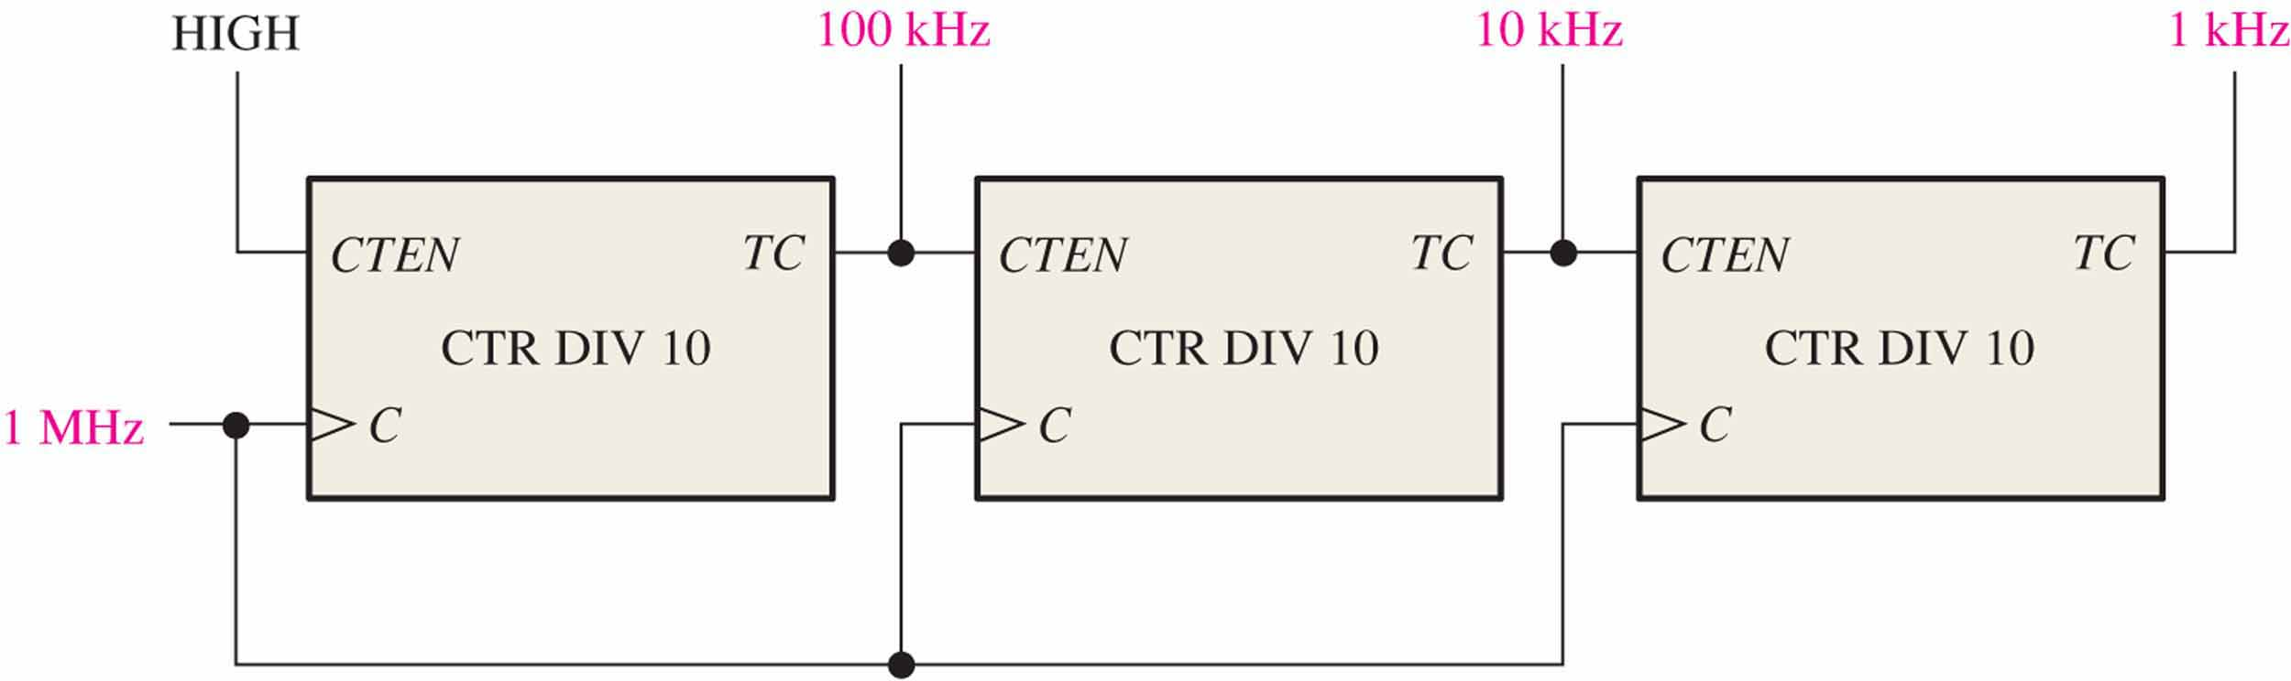
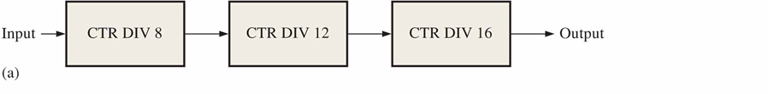
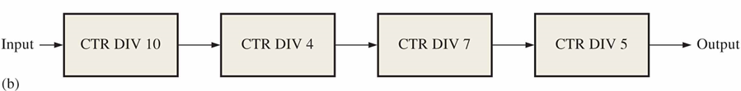
Cascaded counters
Notes:
图1，频率依次/10
图2：频率依次/8，/12，/16，output结果为f/1536
图3：频率依次/10，/4，/7，/5，output结果为f/1400

Slide 27
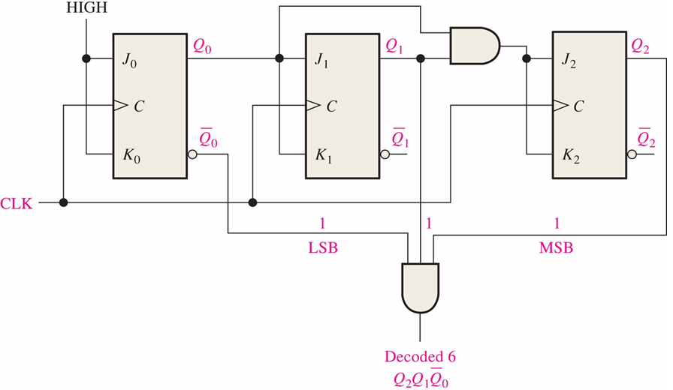
Counter Decoding 计数器译码
Decoding is the detection of a binary number and can be done with an AND gate.
What number is decoded by the and gate?

Slide 28
Partial Decoding 部分译码
The decade counter shown previously incorporates partial decoding (looking at only the MSB and the LSB) to detect 1001. This was possible because this is the first occurrence of this combination in the sequence
Detects 1001 by looking only at two bits

Slide 29
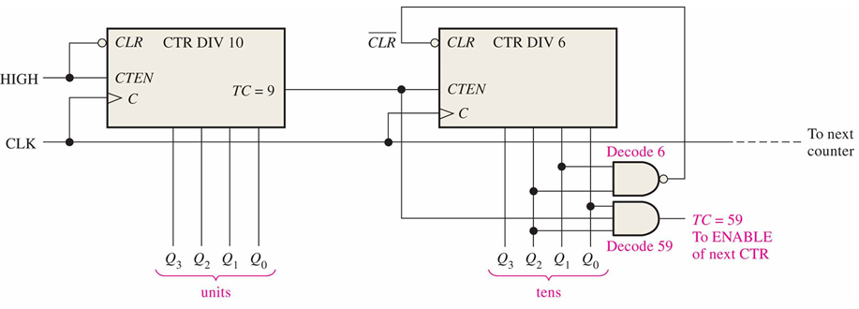
Resetting the Count with a Decoder
The divide-by-60 counter in the text also uses partial decoding to clear the tens count when a 6 was detected.
Notes:
The divide characteristic illustrated here is a good way to obtain a lower frequency using a counter. For example, the 60 Hz power line can be converted to 1 Hz.

Slide 30
Counter Decoding
E.g. Show how to decode state 5 with an active LOW output.

Slide 31
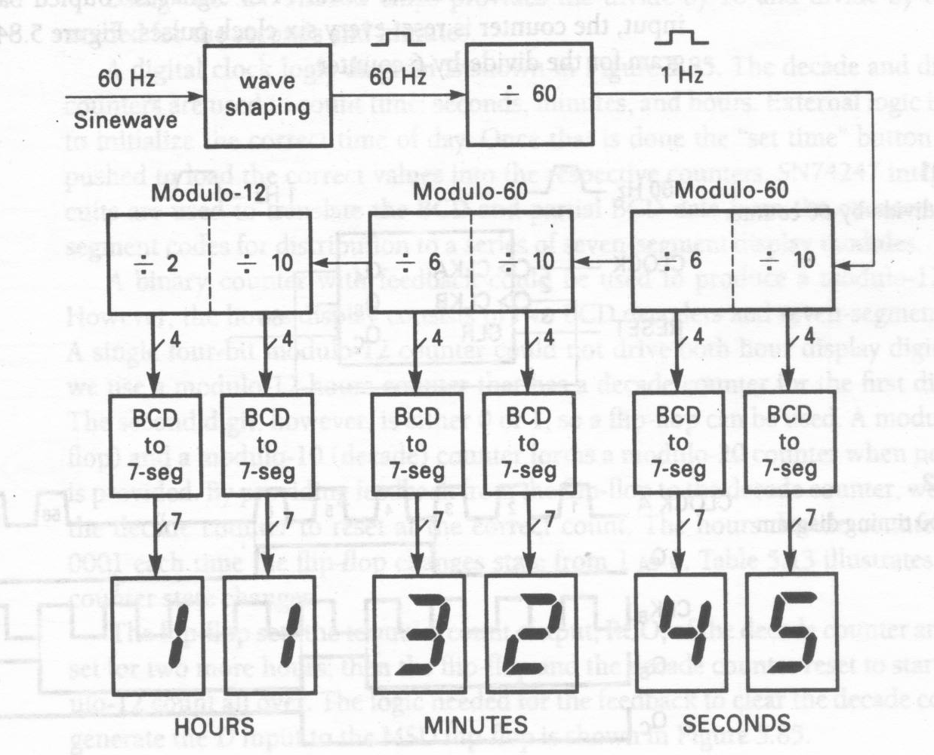
A Counter Application: Digital Clock 数字时钟

Slide 32
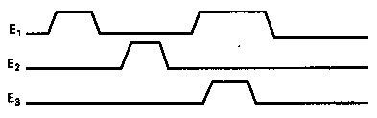
Control Signal Generation by Decoding Counter Outputs
E.g. Using counter to realize following control signals
74LS393:
Dual 4-bit Binary Counter.
双四位二进制计数器

Slide 33
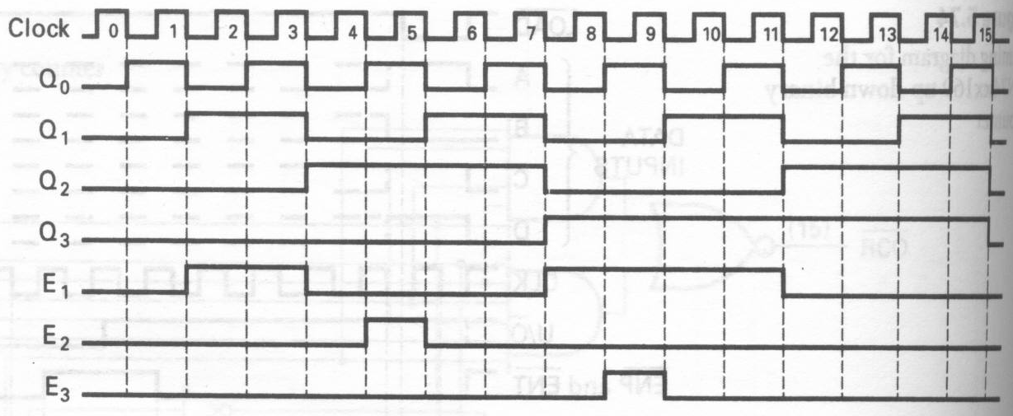
Control Signal Generation by Decoding Counter Outputs
E₁ = f(Q₃,Q₂,Q₁,Q₀) = m(2,3,8,9,10,11)
E₂ = f(Q₃,Q₂,Q₁,Q₀) = m(5)
E₃ = f(Q₃,Q₂,Q₁,Q₀) = m(9)

Slide 34
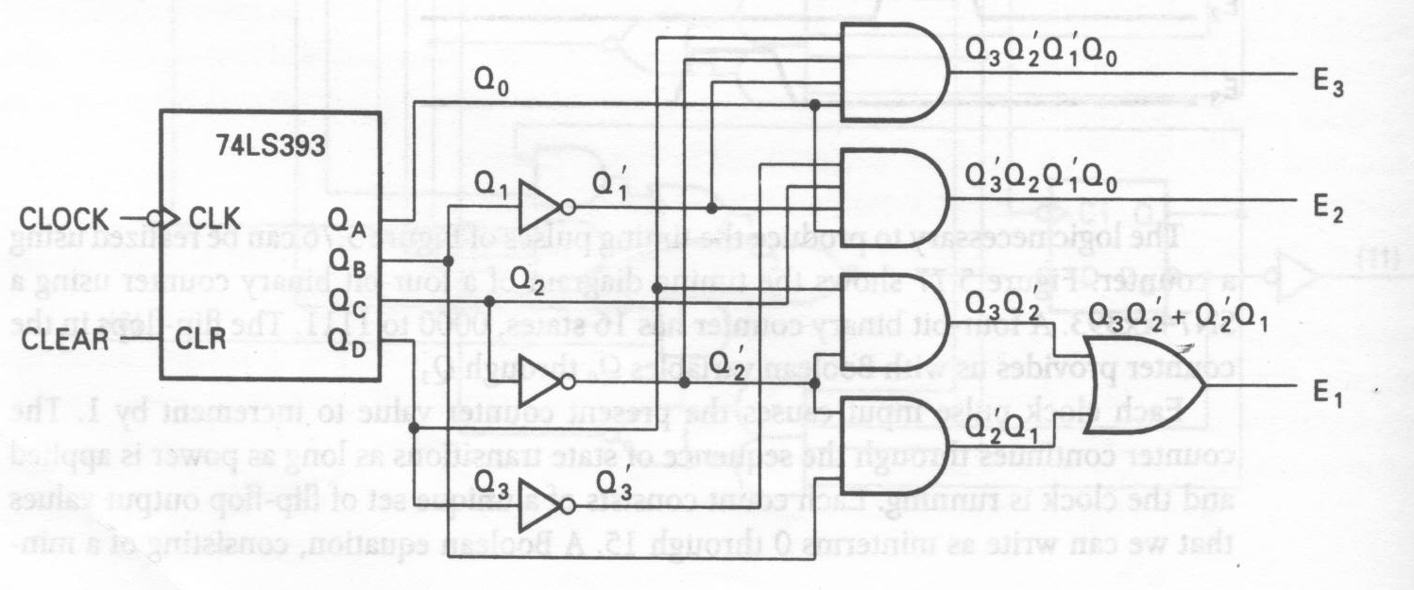
Control Signal Generation by Decoding Counter Outputs

